Slide 1

Title
“ AI-Powered Voice-Guided Presentation: Revolutionizing PPT Explanations ”

Slide 2

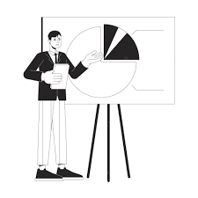
Introduction
Education's pivotal role in societal progress is being reshaped by technology, with traditional methods like PowerPoint presentations falling short in catering to diverse learning styles.
This AI-driven approach aims to automate PowerPoint explanations, fostering a more interactive learning environment.
By automating PPT explanations, it addresses need for comprehensive and adaptable learning experiences.
Fig. 1. Traditional teacher and AI based teacher [1]

Slide 3
Problem Statement
“ Developing an Integrated Educational Platform for Personalized, Accessible, and Cost-effective Learning Experiences ”

Slide 4
Methodology

Slide 5
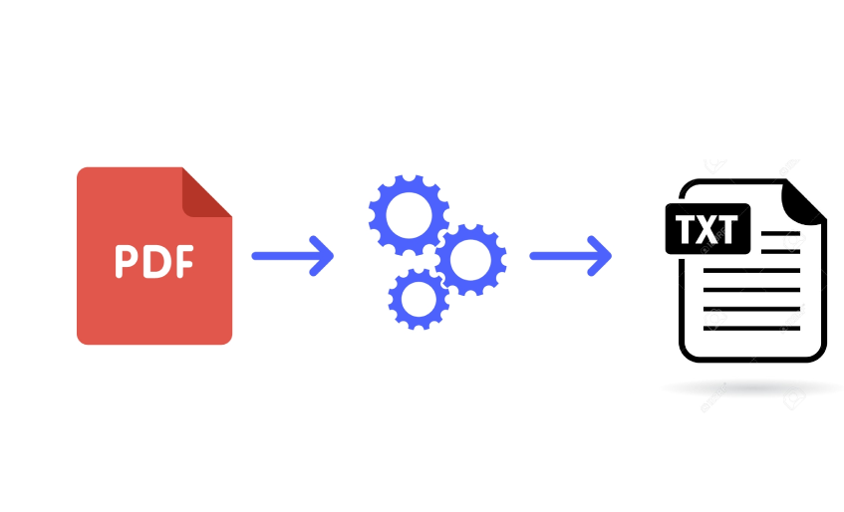
Text Extraction and Preprocessing
Utilized python-pptx library to extract content from PowerPoint (PPT) files.
Utilized preprocessing techniques such as text cleaning, removal of unnecessary formatting to enhance the quality and consistency of the extracted text.

Slide 6
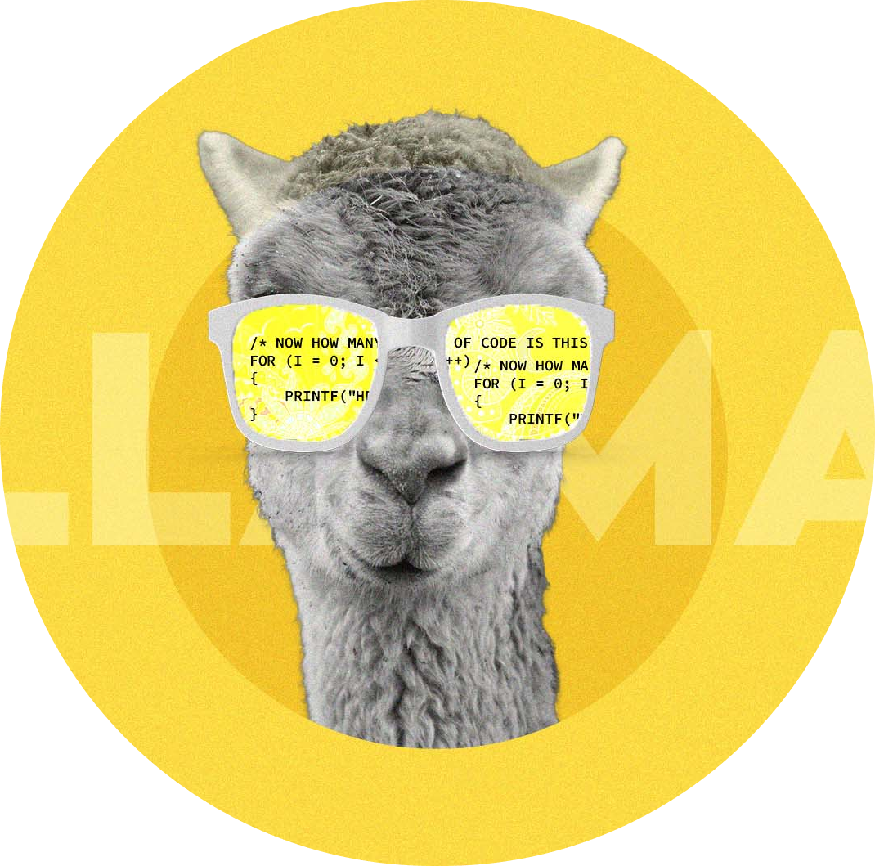
Content Generation using Llama 2
Employed fine-tuned meta-llama/Llama-2-7b-chat-hf for dialogue-based text generation, specifically, for generating slide explanations
Used Prompt Engineering to generate the content from the input text, focusing on key points and maintaining a concise structure.

Slide 7

Content Generation using Gemini pro
Utilize the Gemini Pro model to generate teacher-specific content tailored to the educational context, ensuring that the synthesized script aligns with pedagogical principles and instructional objectives.
Prompt Engineering : We initiated with a set of baseline prompts instructing Gemini Pro to summarize the input text, focusing on key points and maintaining a concise structure.
Gemini Pro utilizes a cutting-edge architecture known as a Mixture of Experts (MoE) for content generation.

Slide 8
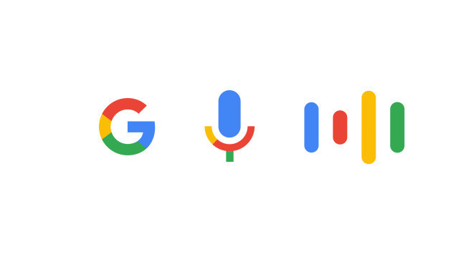
Text-to-Speech Integration
The integration of Google Text-to-Speech emerges as a pivotal component, providing an unparalleled auditory experience.
The gtts's comprehensive features, wide language support, and ability to create a unique brand voice make it a preferred choice.
Google's text-to-speech based on WaveNet outperforming other synthetic voices.
WaveNet generates speech with more natural emphasis and inflection on syllables, phonemes, and words.

Slide 9
Lip-Sync Video Generation
We Used wav2lip lip-sync video generation and fine-tuned it
As per our requirement.
Feature Extraction: Separate convolutional layers process the Mel-spectrogram and video frames to capture relevant features.
Feature Concatenation: The extracted features from audio and video are then combined.
Frame Reconstruction: A series of transposed convolutional layers take the combined features and use them to predict a set of reconstructed video frames.

Slide 10

Web Integration
Client-server architecture is a widely used model for designing and implementing systems. In this architecture, the system is divided into two main components: clients and servers.
Clients: Clients are the end-user devices or applications that initiate requests for services or resources from servers.
Servers: Servers are powerful computers or software applications that respond to client requests by providing requested services or resources.

